Slide 1

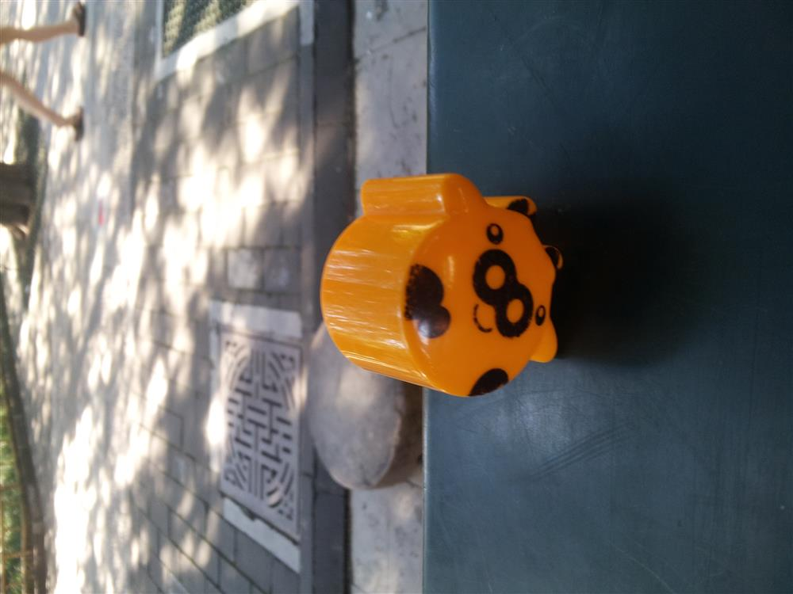
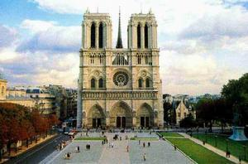

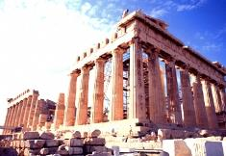
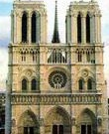
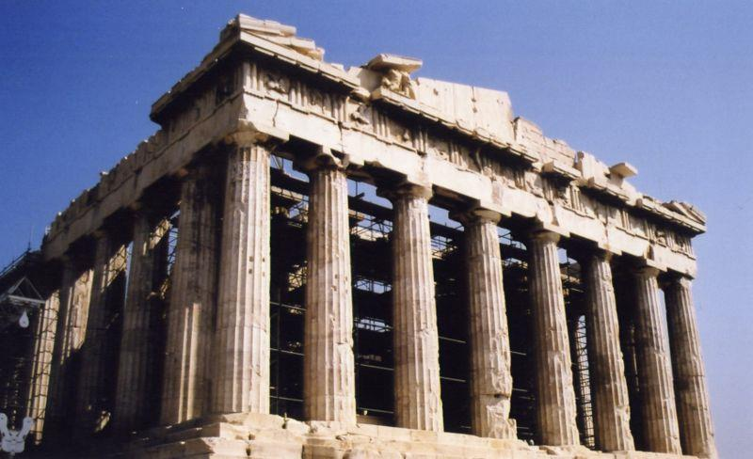
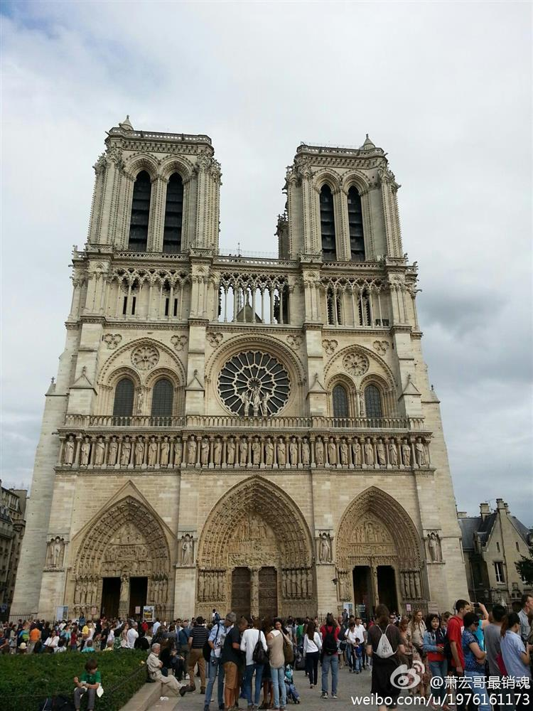
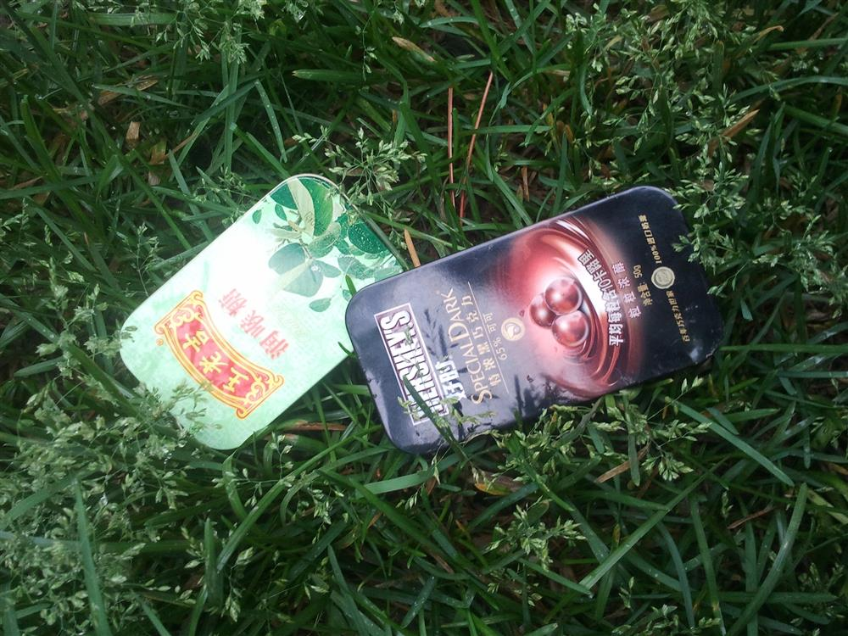
Assignment 1 CS4186
Computer vision and image processing
Instance Search
You are given a collection of 5000 images and 20 testing query images. Each image contains one instance (object). Your task is to implement any two object matching methods for instance search.
Crop
Retrieval
&
Query Image
Top 10 matching images

Slide 2
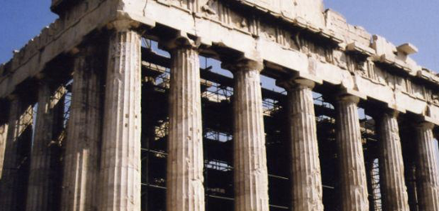
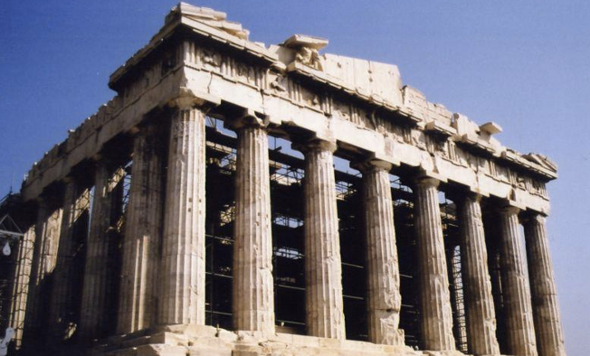
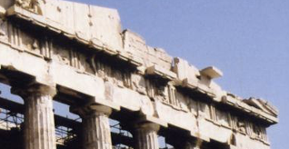
Assignment 1 CS4186
Computer vision and image processing
Method based on the deep neural networks
Feature 1
Feature i
Feature N
Feature 1
Feature i
Feature N
…
…
…
…
…
…
…
…
…
…
Cropped
query patch
Gallery image with
different crop windows
CNN backbone
(pretrained on the ImageNet database)
CNN backbone
(pretrained on the ImageNet database)
1. Measure the feature similarity scores between the query image and all images in the gallery;
2. Rank the retrieval results according to the similarity scores.

Slide 3
Assignment 1 CS4186
Computer vision and image processing
Pytorch implementation of Instance Search.
Preliminaries:
HOW TO INSTALL ANNACONDA: https://www.youtube.com/watch?v=YJC6ldI3hWk WHAT IS IMAGENET DATABASE: https://www.youtube.com/watch?v=gogV2wKKF_8
Notes:
This is a simple pytorch implementation of instance search based on VGG11 backbone (1 query and 1000 gallery images for example). You are also encouraged to use other backbones (e.g. ResNet, Xception, AlexNet …);
This implementation extracts the feature from the last layer of the VGG11 backbone. You could also extract features from other layers;
This algorithm feeds the whole gallery image into the neural network. You could preprocess the gallery images by cropping them using windows with different sizes and shapes to get more fine-grained features;
This code employs the cosine similarity to measure the similarity scores between features. You could use other metrics to measure the similarity scores between features;
Steps:
python extract_feature.py (Extracting the query and gallery features)
python retrieval.py (Retrieving top 5 matching images)

